Slide 1
Decision Tree Decision Table

Slide 2
Decision Tree
A decision tree gives a graphic view of the processing logic involved in decision making and the corresponding actions taken. The edges of a decision tree represent conditions and the leaf nodes represent the actions to be performed depending on the outcome of testing the condition.
Example: -
Consider Library Membership Automation Software (LMS) where it should support the following three options:
New member
Renewal
Cancel membership

Slide 3
Decision Tree
New member option Decision:
Decision: When the 'new member' option is selected, the software asks details about the member like the member's name, address, phone number etc.
Action: If proper information is entered then a membership record for the member is created and a bill is printed for the annual membership charge plus the security deposit payable.
Renewal option Decision:
Decision: If the 'renewal' option is chosen, the LMS asks for the member's name and his membership number to check whether he is a valid member or not.
Action: If the membership is valid then membership expiry date is updated and the annual membership bill is printed, otherwise an error message is displayed.

Slide 4
Decision Tree
Cancel membership option :
Decision: If the 'cancel membership' option is selected, then the software asks for member's name and his membership number.
Action: The membership is cancelled, a cheque for the balance amount due to the member is printed and finally the membership record is deleted from the database.

Slide 5
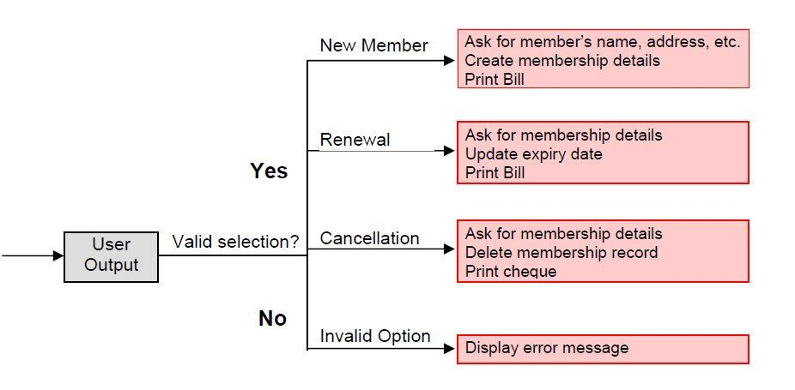
Decision Tree
Decision Tree of LMS

Slide 6
Decision Table
A decision table is used to represent the complex processing logic in a tabular or a matrix form. The upper rows of the table specify the variables or conditions to be evaluated. The lower rows of the table specify the actions to be taken when the corresponding conditions are satisfied. A column in a table is called a rule. A rule implies that if a condition is true, then the corresponding action is to be executed.
Example:
Consider the previously discussed LMS example. The following decision table shows how to represent the LMS problem in a tabular form. Here the table is divided into two parts, the upper part shows the conditions and the lower part shows what actions are taken. Each column of the table is a rule.

Slide 7
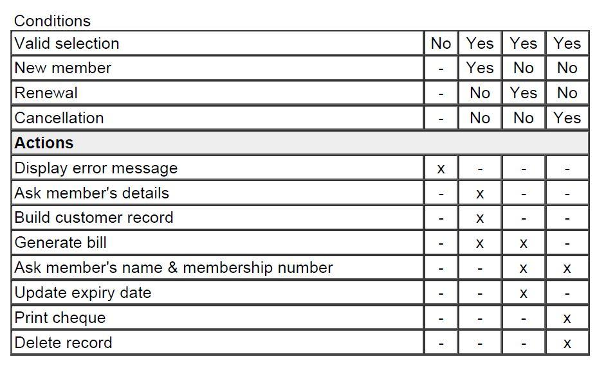
Decision Table
Decision table for LMS

Slide 8
Decision Table
From the above table we can easily understand that, if the valid selection condition is false then the action taken for this condition is 'display error message'. Similarly, the actions taken for other conditions can be inferred from the table.

